Slide 1
Arturo Lituma
Senior Data Analyst

Slide 2
Projects Overview
Case Studies
Game Co.
Budget for marketing is determined by an analysis of worldwide video game sales.
Medical Staffing Agency
Determine medical staffing for the future flu season by analysis of CDC and US Census data.
Rockbuster Stealth LLC
Key overseas clients were examined in order to aid Rockbusters' new internet streaming video platform's effective debut.
Instacart
Analysis of the grocery cart to learn more about data insights and rends.
Airbnb Amsterdam
Explore data of the Amsterdam situation from December 6th, 2018.

Slide 3
1. Gameco

Slide 4
Overview
Objective
Perform a descriptive analysis of a video game data set to foster a better understanding of how GameCo’s new games might fare in the market and determine marketing budget allocations.
Skills
Visualizing results in Excel
Descriptive analysis
Presenting results
Tools used
Excel and PowerPoint
Data Set
Data set consists of video game sales from 1980-2016 that is broken down by units sold by region, platform, genre, title, year, and publisher

Slide 5
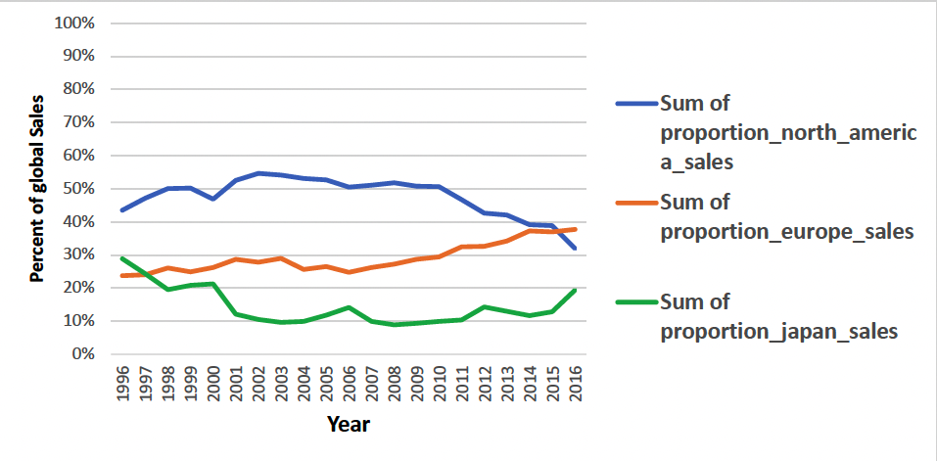
Analysis
The region of the EU was steadily increasing over this period of time.
Japan sales were decreasing over this period of time.
NA region relatively stayed the same, decreasing a bit from 2011 through 2016.

Slide 6
Summary & Next Steps
Overall sales for North America decreased by 15%, while all other regions increased between 2% and 9%.
Europe has experienced consistent growth over the last from 2011-2016 and increased market share by 6%.
Japan has experienced the most significant increase of 9%, with 6% of that growth occurring over the last year.
Due to continually declining sales in North America, increased focus should be on this region.

Slide 7
Medical Staffing Agency

Slide 8
Overview
Objective
Examine trends in influenza in the United States to determine when to send staff and how many to each state.
Skills
Storytelling in Tebleau
Forecasting
Statistical hypothesis testing
Tools used
Excel and Tableau
Data Set
CDC Dataset
US Census Bureau Dataset

Slide 9
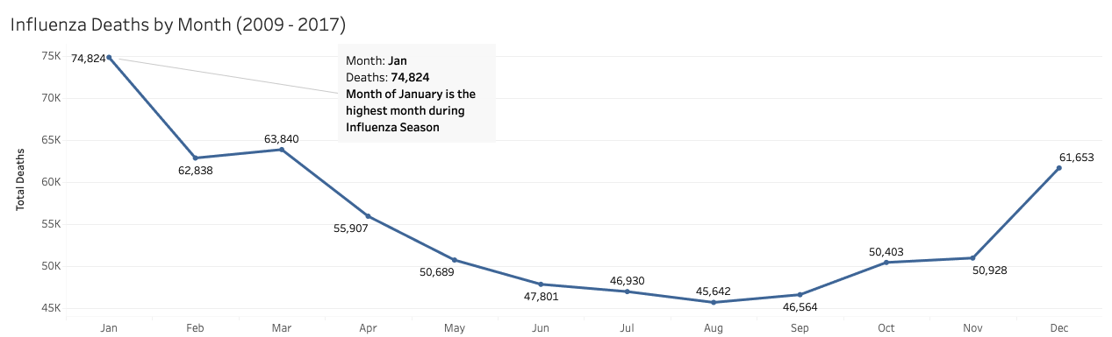
Analysis
When is Flu Season?
Influenza season typically starts in December and ends in March with January being the highest-recorded month for deaths on aggregate.

Slide 10
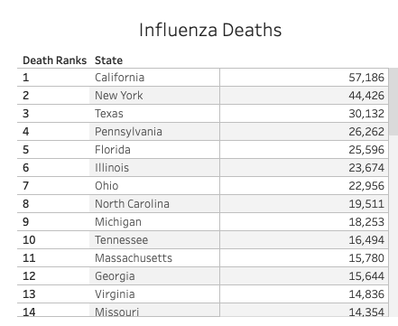
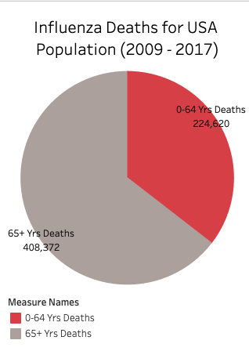
Analysis
State Risk
The top 5 states with the most deaths are California, New York, Texas, Pennsylvania, and Florida.
While the states with the fewest deaths are Alaska, Delaware, Vermont, the District of Columbia, and North Dakota.
Age Population Risk
We have predetermined the age group 65+ is the most vulnerable group due to the comparison in the above pie chart for Influenza deaths.

Slide 11
Summary & Next Steps
According to this analysis, these are the points our insights have for a better Influenza Season:
For the months of December through March, hire additional medical staff to combat the Influenza Season.
The top 5 states California, New York, Texas, Pennsylvania, Florida need more medical staff during the Influenza Season.
The states with a higher 65+ population need more medical staff in their clinics since this age group is considered vulnerable.
Finally, we need more time to research and test different data sets to understand why some states have higher death rates than others like vaccine rates.

Slide 12
Rockbuster Stealth LLC

Slide 13
Overview
Objective
Analyze existing movie licenses to launch an online video rental service to stay competitive
Skills
Joining Tables in SQL
Subqueries in SQL
Common Table Expressions
Tools used
SQL and Tableau
Data Set
Rockbuster database

Slide 14
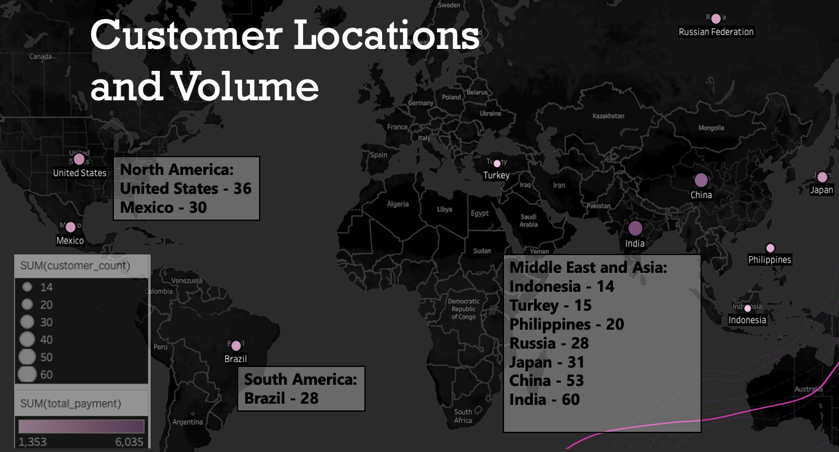
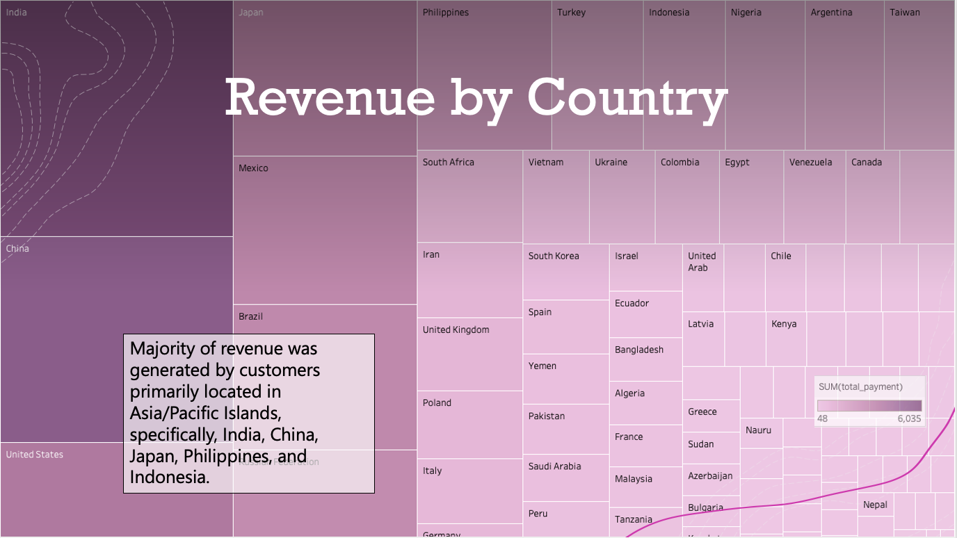
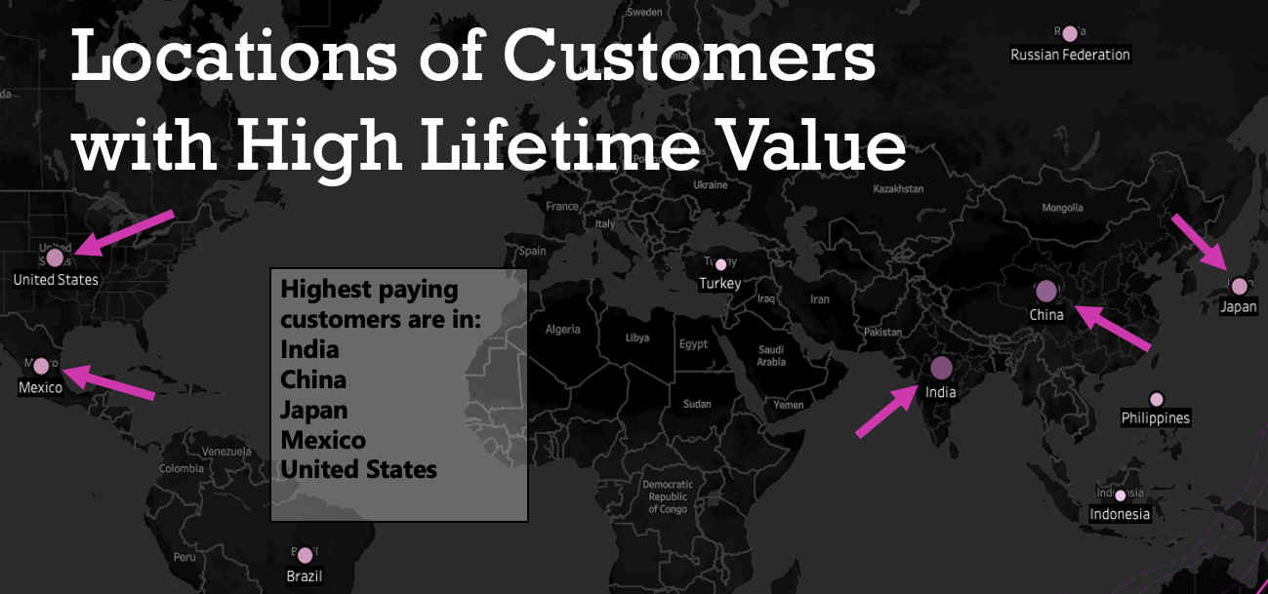
Analysis

Slide 15
Summary & Next Steps
The highest grossing films should be subjected to further analysis to determine what appeals to these audiences.
Asia should be the main region of interest.
Remove the movies with the lowest income to make way for the movies with the most potential for revenue.

Slide 16
Instacart

Slide 17
Overview
Objective
Analysis of the grocery cart to learn more about data insights and rends.
Skills
Python
Jupyter Notebooks
Pandas, Numpy, Matplotlib, and Seaborn
Tools used
Jupyter Notebooks
Python – Pandas, Numpy, Matplotlib, and Seaborn
Data Set
Instacart Dataset

Slide 18
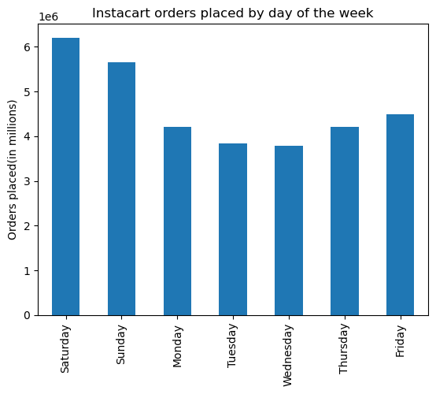
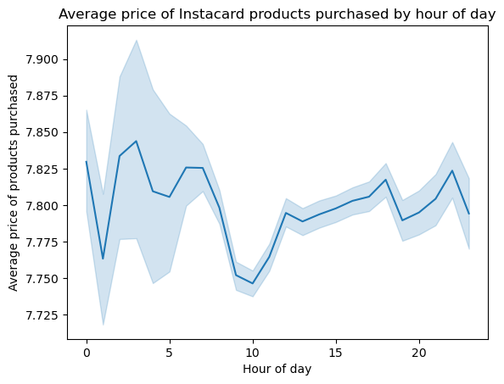
Analysis

Slide 19
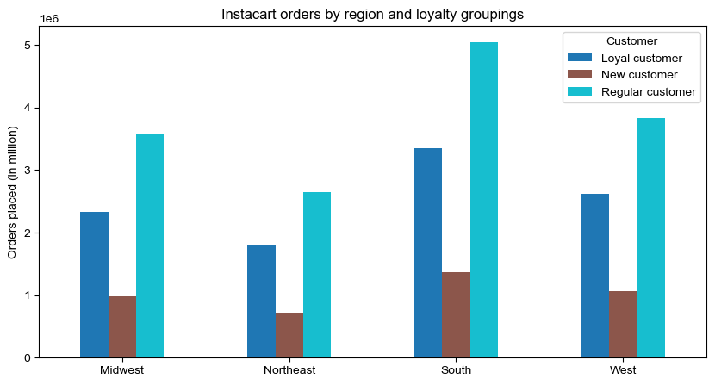
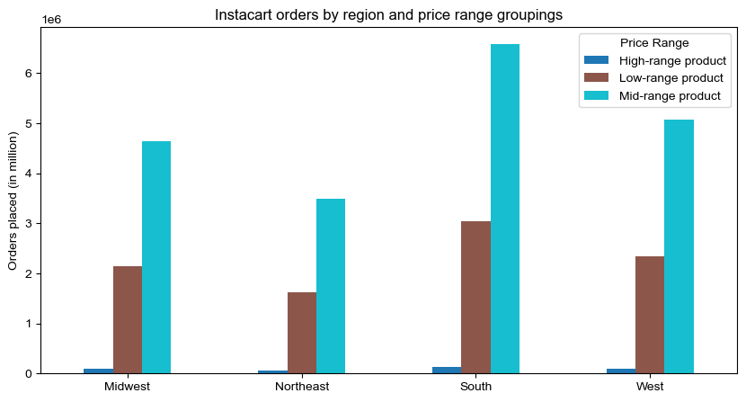
Analysis

Slide 20
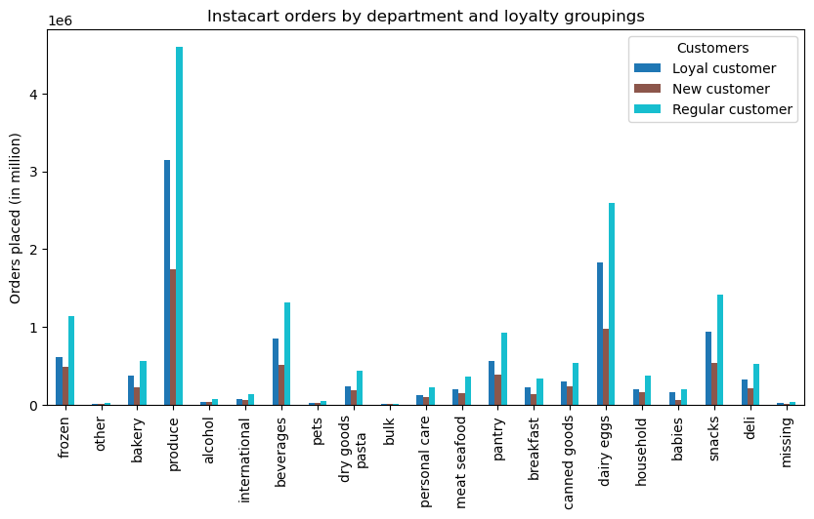
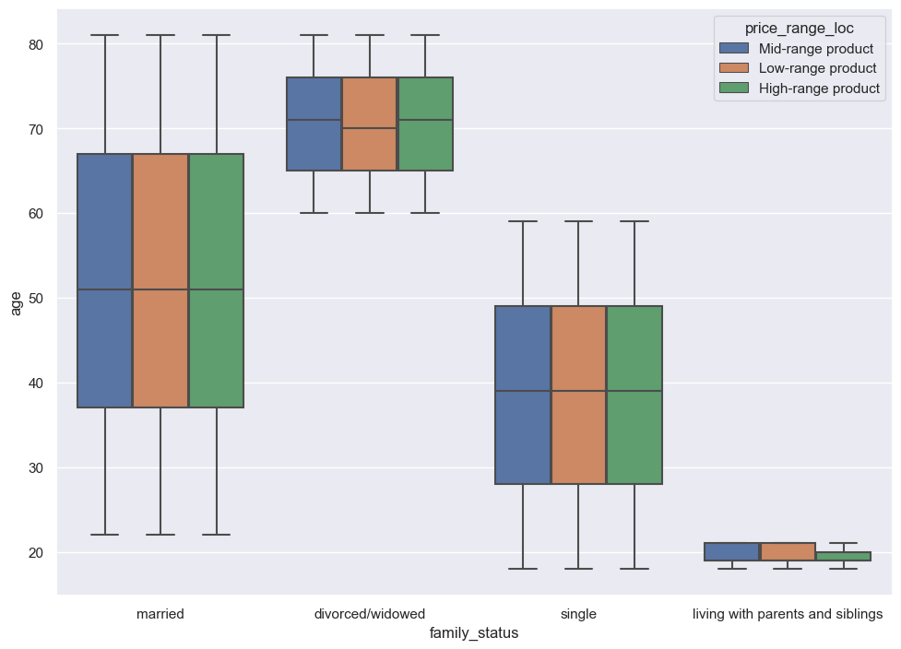
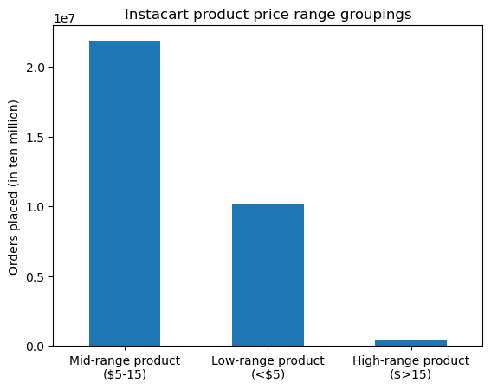
Analysis

Slide 21
Summary & Next Steps
Perhaps running specials on produce and dairy/eggs during a weekday between 9am and 6pm would be beneficial.
Have some discounts and loyalty features for loyal and regular customers

Slide 22
Airbnb amsterdam

Slide 23
Overview
Objective
Analysis of the grocery cart to learn more about data insights and rends.
Skills
Python - Jupyter Notebooks
Tableau
Tools used
Tableau
Python – Pandas, Numpy, Matplotlib, and Seaborn
Data Set
Airbnb Amsterdam December 2018 Dataset

Slide 24
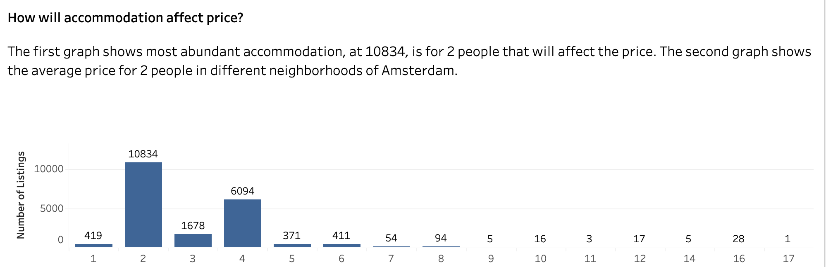
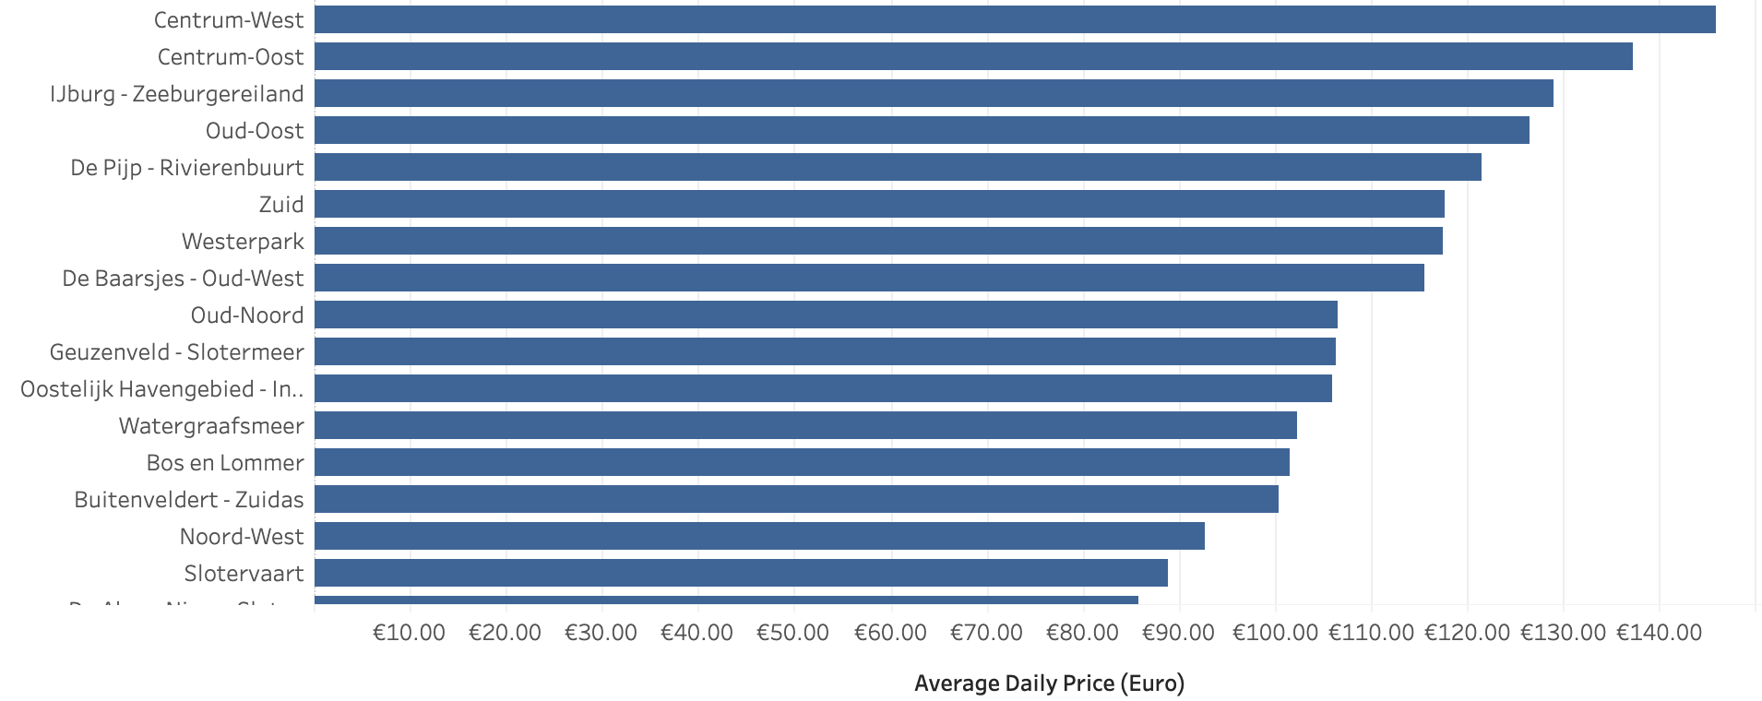
Analysis

Slide 25
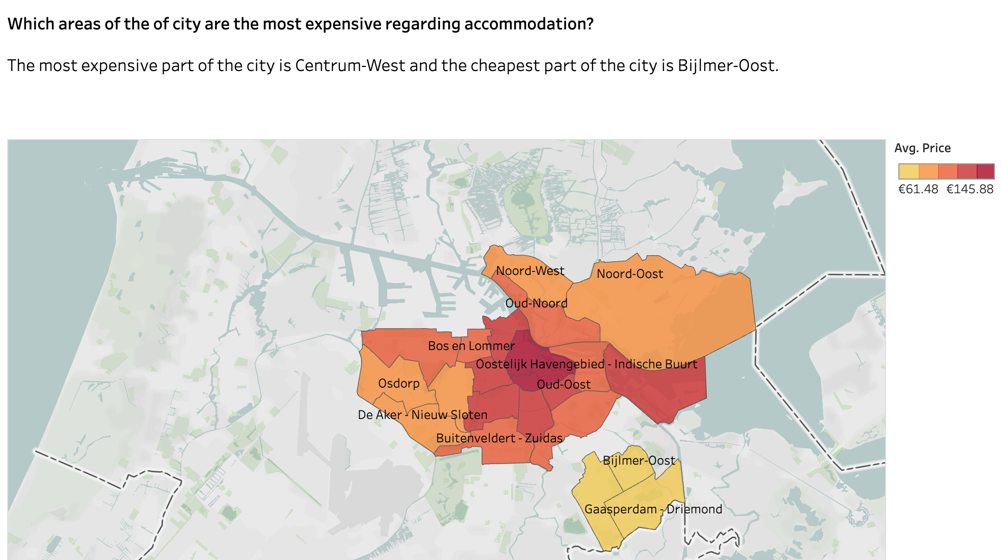
Analysis

Slide 26
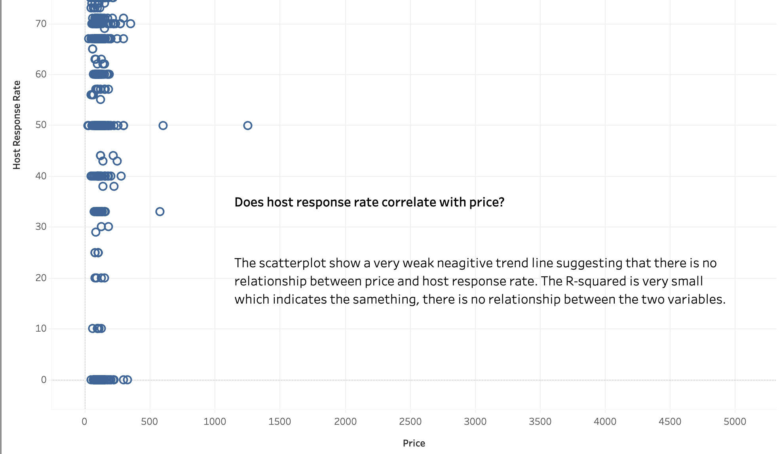
Analysis

Slide 27
Summary & Next Steps
The more center the location the more expensive the daily average was for 2 people.
The spatial analysis helped look at the cheapest and most expensive neighborhoods in Amsterdam.
Data is limited to one point in time. Cannot conduct a time-series analysis to see how price and influencing factors have changed over time.
Investigate further into the time series data of the areas to have a better understanding of the price fluctuations.

